Slide 1




BDM- Capstone Project
Strategic Resilience :
Data-Driven Customer Centric Sales and Marketing for Improving Pesticide Shop Performance
Presented by
IITM Online BS Degree Program,
Indian Institute of Technology, Madras
Chennai Tamil Nadu, India, 600036
Name: Pranab Kumar Manna
Roll number: 22f1000887
1

Slide 2

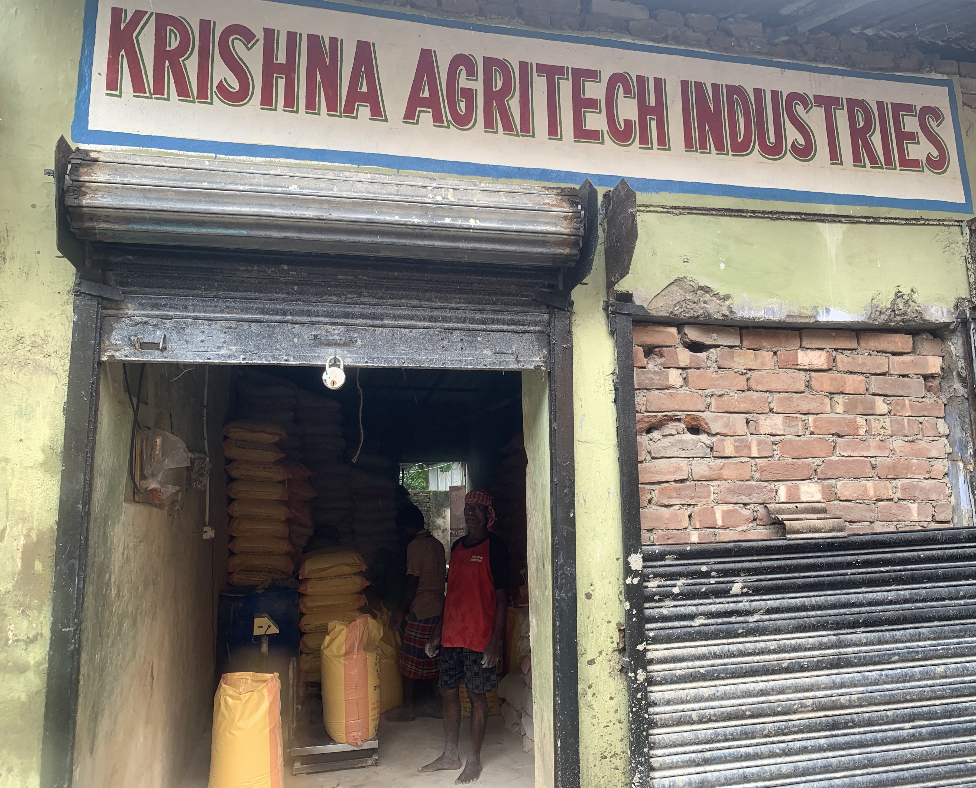





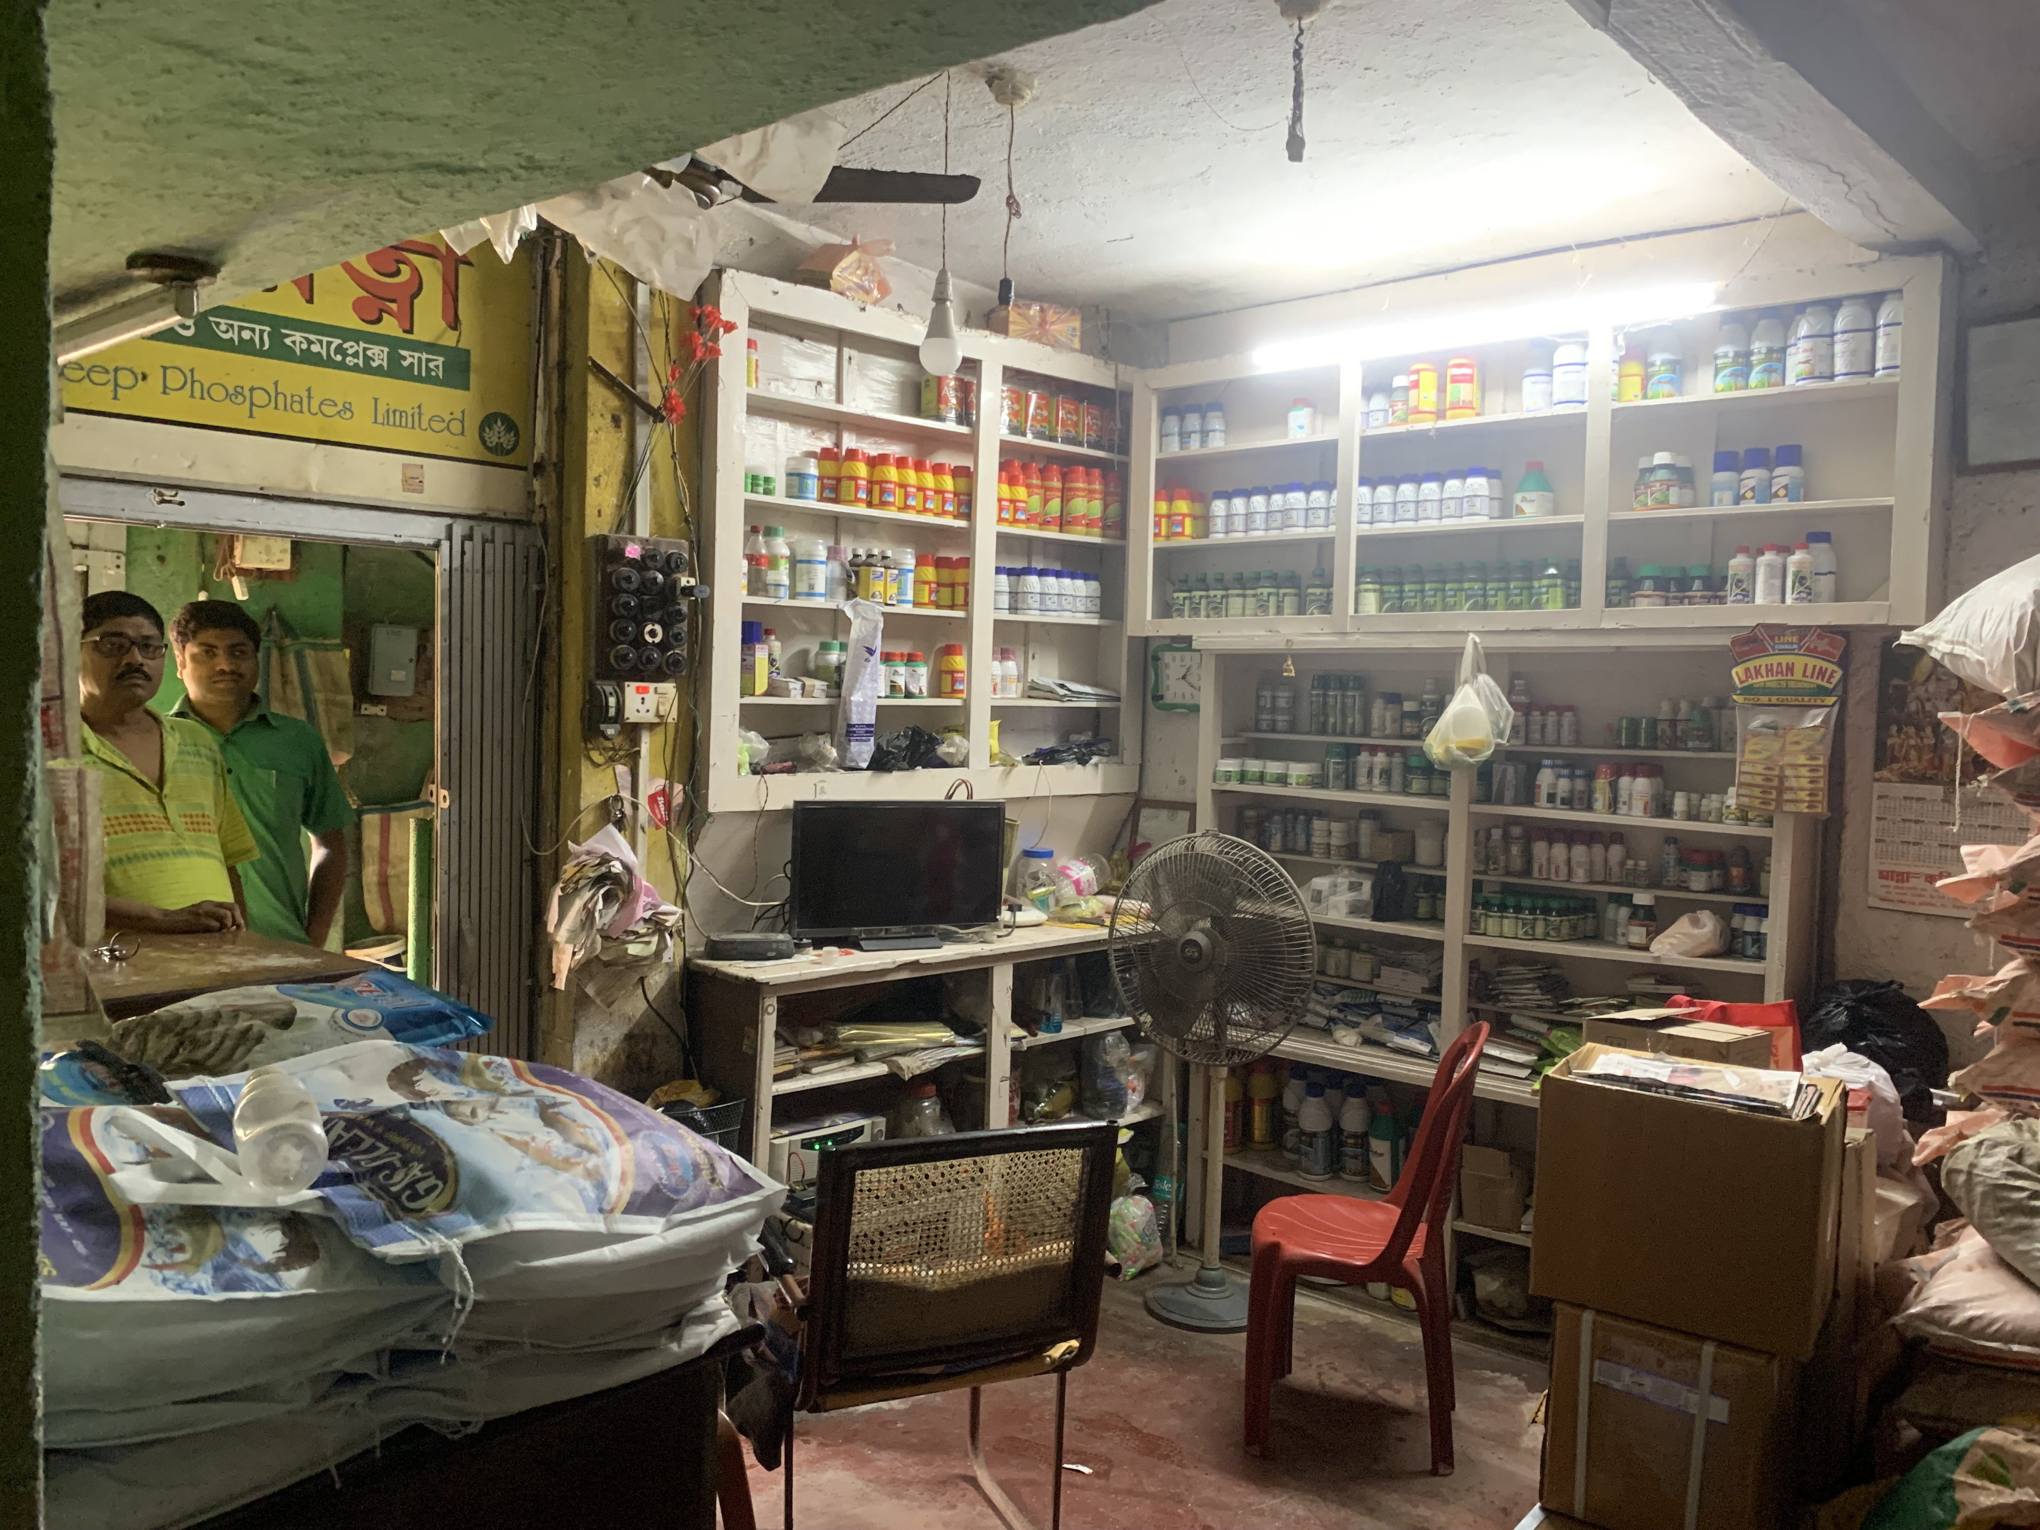








About the Business – Krishna Agritech Industries
Established: 1993, Amtala(WB)
Owners: Shyamaly Pal, Krishnendu Pal
Products: Insecticide, Herbicide, Fungicide,
Plant Nutrition
Focus:
Customer Retention, Sustainable Growth
Krishna Agritech Industries
Growing online presence via Amazon, counter service and upcoming own website
Identified base load products, contributing 80% on revenue
Growth
Expansion into manufacturing unit with research team
Growth
Repeat purchase of products
by loyal customer
Annual turnover of ~₹30 lakhs with
steady farmer and retail client
**key- Insecticides (Ekka,Dursban,Samrat 70,Pegasus,Simodis); Herbicides (Suspend,Iris,Safal 71,Agil,2,4-D);Fugicides (Saaf,Contaf Plus,Indofil M45,Baan,Ridomil Gold); Plant Nutriotion(Poushak, Agromin Gold, Isabion, El++, Tropicona) 2

Slide 3



Uncovering Problems and Aligning Objectives for Improvement
Problem Statement
Objective
Goal
Ineffective inventory management causing overstocking, expirations and stockouts.
Decreasing customer base and retention issues due to generic service, limited follow-up and growing competition from large retailers and online platforms.
Poor demand forecasting, relying on guess instead of data-driven predictions and lack of profit margin optimization.
Apply data-driven analysis (sales, purchase, inventory, customer survey) to uncover trends, forecast demand and optimize inventory.
Leverage customer-centric strategies (segmentation, engagement, loyalty programs, personalized offers) to enhance satisfaction and retention.
Improve decision-making through data integration, ensuring a holistic view of operations.
Increase efficiency in operations (inventory optimization, demand forecasting, dynamic restocking).
Boost customer satisfaction through trust, availability and personalized engagement.
3

Slide 4





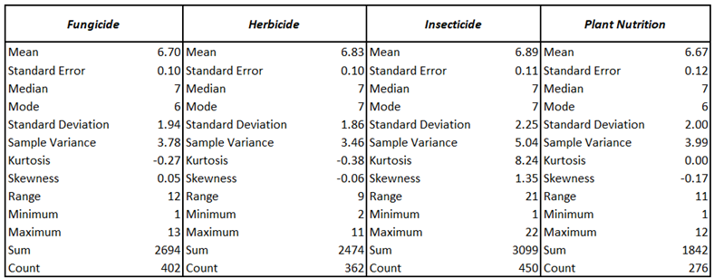
Nature of Data Collected and Analyzing Business Data: Attributes, Sources, Statistics
Data Types & Volume
Key Metadata Attributes
Sales, purchase, inventory and customer survey data. 22 weeks (Nov’24- Apr’25) of historical data across 4 pesticide categories.
Total number of transactions during that 22 weeks is 1,490.
Total number of original and derived columns is 14.
Time Data: Sales_Date (transaction date),Weeks, Season
Customer Related: Customer_Name, Region (customer location), Customer_Type (Retail, Large)
Products Related: Product_Name, Category, Package_Quantity
Transactional: Sale_Quantity (No of units sold), Profit, Sale_Price (Price per unit/package), Revenue (Total sales amount)
Data Source
Descriptive Statistics
Operational business data provided by Krishna Agritech Industries.
Customer preference survey data to supplement quantitative findings with qualitative insights which collected using Google Form.
Total revenue: Rs 48.1 lakh. High variability in insecticides, stable fungicide/herbicide sales.
**Key- uniform demand for all four categories as mean(~6.8) is almost same. Insecticides sales distribution is highly peaked (Kurtosis is 8.24), right skew (Skewness is 1.34) ,indicates occasional weeks have high demand. 4

Slide 5






Data Cleaning Process and Analytical Methodology to Resolve Business Challenges
Revenue Vs
Sales Analysis
Profiling
Analyze data structure and quality.
Handle Missing Values
Fill or estimate missing data.
Outlier Handling
Address unusual data points.
Validation
Check data for accuracy.
De-duplication
Remove redundant entries.
Descriptive Analysis
Profit Margin
Analysis
Initial Auditing :
~12% missing values in sales, purchase and inventory.
~8% duplicate records across sheets.
Inconsistent formats in dates, units, product names, customer types, and regions.
Errors in numerical fields (Ex- negative stock, varying prices).
Results After Pre-Process:
Achieved 98% dataset completeness with high reliability. Eliminated ambiguities, ensuring robust statistical analysis and a cleaned data.
Customer Survey
Analysis
ABC Analysis
Trend Analysis
and
Forecasting
**Key- Revenue Vs. Sales to asses correlation between sales and revenue. Profit Margin, is being use for contribution of profit on sales. ABC analysis for identifying key performing products. trend analysis for demand forecasting used ARIMA model (7 days Moving Avg). Survey for feedback analysis. 5

Slide 6
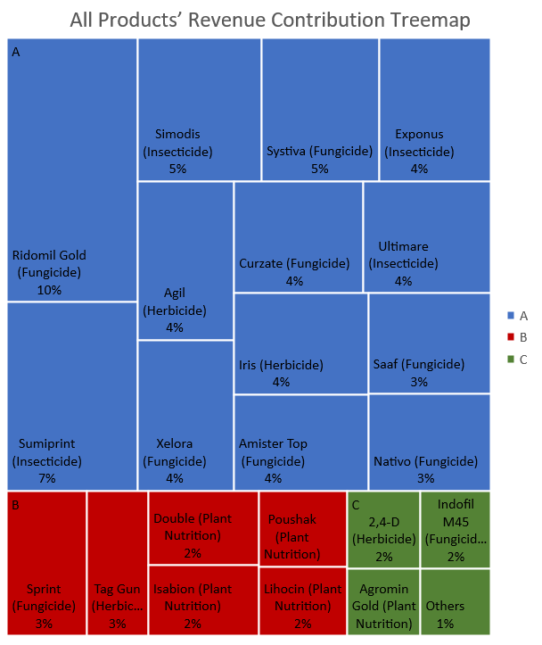
Results/Findings Overview: Visualizing Revenue, Sales and Profit Making Products
**Key- Pearson value is 0.892, a strong positive correlation, indicates higher sales generates higher revenue and data are tightly clustered around trendline, relation is consistent. A(80%)-would be main focus high stocks, B(15%)-less stocks for saving time and money ,C(5%)-mixed products cross selling. 6

Slide 7
Results/Findings Overview: Visualizing Survey, Demand Forecast
Demand Forecasting:
Sales variability is high on Nov-24 and lowest during mid Dec to early Jan-25, indicating predicable demand drops.
Sales peak occurs in W8, W11, W17 indicates pushing inventory stocks. Post W18, reduce inventory significantly to minimize the overstock.
Forecasted sales shows a continuous downward trend for all products but for Herbicide, a noticeable cyclic pattern, indicating seasonal or promotional effects
Customer Survey:
Online Platforms are slightly ahead in offering variety, discounts, offers, promotions and non-seasonal products.
**Key- Fungicide, Insecticide, Herbicide and Plant Nutrition are fluctuated in this range (45, 250), (41, 250), (52, 210) and (45, 150) units in the first 21 weeks, trend dips sharply after week 17 and stabilizes at lower levels approaching week 21. where ever sales peak occurs in W8, W11, W17 for all products. forecasted sales (weeks 23-30) shows a continuous and significant downward trend for all products but for Herbicide, there is noticeable cyclic pattern, possibly indicating seasonal or promotional effects and there is slight increase in demands around 101 units next 2 months (Apr’25-May’25) .
7

Slide 8







Key Insights from Data Analysis: Profitability, Demand and Customer Behavior
Descriptive/Overall Insights
Fungicide and Herbicides (Base Load) products are providing predicable, steady weekly sales which supports planning and cash-flow stability. They
have highest sales 2,694 and 3,099 units respectively.
Revenue and Product Concentration
ABC analysis confirmed insecticides(Ridomil Gold, Exponus, Sumiprint) drive the bulk of revenue and profit. Some products (Saaf, Ekka, 24-D) sale in high volume but generate very little profit.
01
02
Product Profitability Insights
Ridomil Gold, Sumiprint, Exponus, Simodis are the top profitable products based on their popularity.
Seasonality and Demand Fluctuation
Seasonal demand spikes (Weeks 8, 11, 17) align with crop cycles. Herbicides showed moderate growth potential, while Plant Nutrition displayed a downward demand trend.
03
04
Customer Purchase Patterns
Local customers trust Krishna Agritech for quality & trust. Online platforms win on convenience & variety; competitors attract on price.
Operational and Data Insights
Initial data was fragmented and inconsistent, making it hard to form a holistic view.
05
06
8

Slide 9


Business Impact and Strategic Recommendations
Impact Assessment
Recommendations
Financial Performance
Higher Profitability: Prioritizing high-margin products like Ridomil Gold and Exponus is expected to raise overall profit margins by reducing reliance on low-return items.
Capital Efficiency: Optimized inventory management reduces cash tied up in slow-moving products, freeing working capital for faster-selling, profitable items.
Operational Efficiency
Reduced Stockouts and Wastage: Forecast-driven stocking minimizes lost sales during peak demand and cuts product expiry losses.
Customer Retention and Growth
Improved Loyalty: Personalized offers and follow-ups strengthen customer relationships, reducing churn, especially among large farmers who contribute significantly to revenue.
Customer Satisfaction: Better product availability and differentiated service enhance trust and repeat purchases.
Market Competitiveness
Differentiation from Competitors: By leveraging trust, assured product quality and expert support, Krishna Agritech can compete beyond price wars with online platforms.
New Market Reach: Expansion into digital sales channels and regional growth opportunities increases visibility and attracts new customer segments.
Long-Term Sustainability
Strategic Resilience: Seasonal demand forecasting and dynamic inventory planning align the business with agricultural cycles, ensuring long-term relevance.
Growth Readiness: With structured processes in place, the shop can scale operations and replicate this model across branches or regions.
Dynamic Inventory Optimization
Prioritize high-margin products (Ridomil Gold, Exponus, Sumiprint) with minimum stock thresholds during peak seasons.
Use sales forecasting models (moving averages, seasonality adjustments) to avoid stockouts and cut waste.
Customer Retention Strategy
Introduce loyalty programs and personalized offers, especially for large farmers who generate higher ticket sizes.
Provide proactive communication (reminders before crop cycles, advisory tips, follow-ups after purchase).
Differentiate through service quality—position the shop as a trusted local advisor, not just a seller.
Pricing and Competitive Positioning
Benchmark prices against nearby stores and online platforms, especially for popular but low-margin products.
Offer time-limited promotions on perishable or slow-moving products to free up capital.
Channel and Market Expansion
Explore partnerships with e-commerce platforms to capture digitally inclined customers.
Expand offline presence in nearby regions where trust in local stores is still strong.
Bundle smaller C-class items (like Plant Nutrition) with high-performing A-class products to improve their uptake.
Continuous Feedback and Data Integration
Keep integrating customer feedback into decision-making (simple surveys, WhatsApp feedback, or POS prompts).
Maintain a consolidated database for sales, purchases, and stock to reduce errors and enable ongoing analytics.
9

Slide 10
Thank You
Any Questions?
Do you have any questions or comments for me before we concluded?
10

